Slide 1
M O D U L E - 5

Slide 2
M A I N T E N A N C E

Slide 3
INTRODUCTION
It is a task that is likely to happen when the software is delivered to the customer site, & it is installed and operational
Delivery or release of a software inaugurates the maintenance phase of life cycle
Consumes 40%-70% of cost of entire life cycle
It may span for 20 years

Slide 4
INTRODUCTION
Software Maintenance is a very broad activity that includes
Error corrections
Enhancements of capabilities
Deletion of obsolete capabilities
Optimization
Any work done to change the software after it is in operation is considered as maintenance work
The purpose is to preserve the value of the software over time

Slide 5
CATEGORIES OF MAINTENANCE
Corrective maintenance
Adaptive maintenance
Perfective maintenance

Slide 6
CORRECTIVE MAINTENANCE
This refer to modifications initiated due to defects appearing in the software, while it is in use
Defects arises due to
Design errors
Logic errors
Coding errors

Slide 7
CORRECTIVE MAINTENANCE
Design errors occur when changes made to the software are
Incorrect
Incomplete
Wrongly communicated
Logic errors occur due to
Invalid tests & conclusions
Incorrect implementation of design specification
Faulty logic flow
Incomplete test data
Coding errors arises due to
Incorrect implementation of detailed design
Incorrect use of source code logic
Data processing errors
System performance errors

Slide 8
Patching
If a system failure occurs, actions are taken to restore the operation
Maintenance personnel sometimes perform emergency fixes called as patching
This method leads to many problems
Increase program complexity
Unforeseen ripple effects
change to one part of a program may affect other sections in an unpredictable manner
This leads to distortion in the logic of the system

Slide 9
ADAPTIVE MAINTENANCE
It includes modifying the software to adapt to the changes in the environment.
Environment refers to the external influences acting on a software
Eg:
Business rules
Govt policies
Work patterns
Software & hardware platforms
A change to the environment require modifications to the software
Modifications happens when software moves to a different hardware or software platform

Slide 10
PERFECTIVE MAINTENANCE
This maintenance happens for improving
Processing efficiency
Performance
Changeability of the software
User tries to expand the requirements & enhance existing system functionality
This maintenance is also called Enhancement
Enhancements are done to
Make the product better
Faster
Better documented
structured

Slide 11
Other types of maintenance
Maintenance increase in the complexity of the software,
The work is required to be done to reduce it, if possible.
This work may be named as preventive maintenance.

Slide 12
PREVENTIVE MAINTENANCE.
Aim of this maintenance is to make the program understandable
Activities include
Code restructuring
Code optimization
Documentation updating
This reduces the complexity of the code

Slide 13
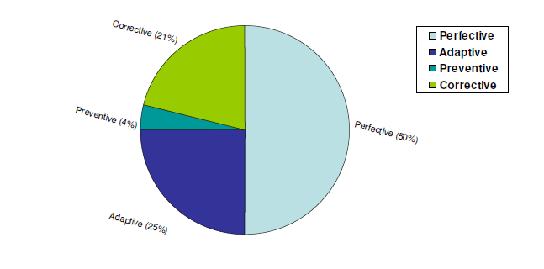

Slide 14
Problems during maintenance
Often the program is written by one person & maintenance done by another person
Often the program is changed by person who did not understand it clearly.
Program listings are not structured.
High staff turnover.

Slide 15
Solutions
Budget and effort reallocation
Time & resources are to be invested for the development of maintainable systems rather than un-maintainable systems
Complete replacement of the system
If maintenance cost of existing system is greater than cost of developing a new one, it is better to develop new one from scratch
Maintenance of existing system
Complete replacement of a system is not a viable option
Current s/m must have the potential to evolve to the higher state
Existing s/m must integrate to other ones in a cost effective manner

Slide 16
Thank You……….

